Slide 1
PAC Unpacked:
Understanding the Importance of SNA’s Political Action Committee
© 2022 School Nutrition Association | 2900 S. Quincy St., Suite 700, Arlington, VA 22206 | www.schoolnutrition.org
Notes:
PAC Unpacked
Welcome Everyone!

Slide 2
Learning Objectives
Understand the importance of PAC
Know how donations are collected
Understand donation distribution
Increase state and local participation
© 2023 School Nutrition Association

Slide 3
What is a Political Action Committee (PAC)?
The Federal Election Commission defines PACs as:
Popular term for a political committee that is neither a party committee nor an authorized committee of a candidate.
Political Action Committees are established and administered by corporations, labor unions, membership organizations or trade associations with the purpose of raising monies to contribute to candidates and incumbents who share common political interests.
These committees can solicit contributions only from individuals associated with a connected or sponsoring organization.
© 2023 School Nutrition Association
Notes:
What is a Political Action Committee? (PAC)
PAC provides the necessary financial support to get a seat at the table to make sure our positions are known and understood by our elected officials.
Member contributions to the SNA PAC are voluntary and are not tax deductible. They have no impact on your membership to SNA.
All contributions are made in compliance with the Federal Election Commission regulations

Slide 4
What is a Political Action Committee (PAC)?
Political Action Committees support an organization’s common values and political goals
Since corporate contributions are prohibited, political action committees allow organizations and its members to support federal candidates or elected officials who share the same policy goals
© 2023 School Nutrition Association

Slide 5
PAC and the Legislative Process
SNA PAC helps support SNA’s legislative goals by keeping the conversation
going on Capitol Hill
Educate members of Congress about child nutrition programs
Support federally elected officials and candidates who back our positions on
child nutrition programs
Ensures that SNA has a "seat at the table" to work in favor of child nutrition
programs
Contributions are voted on by the PAC Committee
© 2023 School Nutrition Association
Notes:
What is a PAC?
A political action committee supports an organization's political goals by collecting money from people who share those goals and making contributions to political candidates who support those goals.
SNA Public Policy and Legislation Committee (PPL) presents a legislative position paper every year at the annual Legislative Action Conference. PAC supports that paper and educates Members of Congress on the issues.
Typically, PAC gives to Members who sit on committees with jurisdiction over child nutrition programs.

Slide 6
How Do We Determine Targets For Contributions?
House Committee on Education and Labor
House/Senate Committee on Agriculture
House/Senate Committee on Appropriations
Bi-partisan in nature
© 2023 School Nutrition Association
Notes:
How We Determine Targets for Contributions?
These are the committees in the House and Senate with jurisdiction over the laws governing our programs.
Our donations are not partisan in nature.
SNA actively identifies Congressional Members or candidates who support our issues, are on committees with jurisdiction over our issues
Typically, PAC recipients serve on committees that reauthorize child nutrition programs or have expressed strong support or record in child nutrition programs.
All PAC contributions are previously approved by the PAC Committee.

Slide 7
Why It Matters?
Continues to keep SNA priorities in the forefront, throughout the year, beyond LAC
Works in conjunction with Action Alerts and other grassroots advocacy
Builds relationships with Members of Congress
SNA presence on Child Nutrition Issues
© 2023 School Nutrition Association

Slide 8
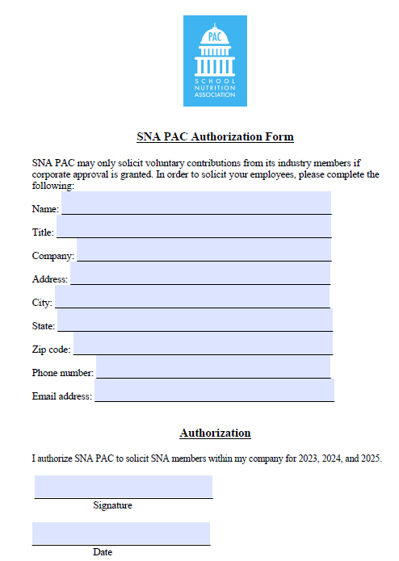
SNA Industry Members
Before you can participate in the SNA PAC, your corporation must provide annual authorization to solicit PAC donations.
© 2023 School Nutrition Association
Notes:
SNA Industry Members
SNA PAC may solicit and receive contributions from industry members, but only with prior corporate authorization. Corporations must sign this authorization form allowing SNA to solicit their employees who are SNA members.
One of the principal functions of SNA is to provide a voice for school nutrition on policy matters in Washington, DC.
An important part of SNA’s legislative efforts is the School Nutrition Association Political Action Committee (SNA PAC), a voluntary, nonprofit, bipartisan committee that contributes to members of Congress who support school nutrition programs.
SNA PAC is governed by volunteer leaders of SNA, and it relies exclusively on its members for its financial support.
The PAC allows SNA’s advocacy team to educate members of Congress on school nutrition programs. It also gives them a “seat at the table” to work in favor of school nutrition programs, ensuring our positions are heard. SNA PAC supports candidates based on committee assignment and their voting record.

Slide 9
Ways SNA Collects PAC Contributions
Box check on membership renewal form
Online on the SNA website
Text 2Give
Conferences
© 2023 School Nutrition Association
Notes:
Ways SNA Collects PAC Contributions
SNA members can contribute when they renew their membership by checking the box on their renewal form and indicating the amount they wish to contribute.
Members can also visit the PAC booth during the Legislative Action Conference, as well as the Annual National Conference and make their contributions by check, credit card or in cash. Please note, per FEC regulations, SNA can only accept up to $100 in cash.
At any time, members can contribute online on the SNA website or via text by texting “schoolmeals” to 243725.

Slide 10
PAC Contribution Guidelines
Only SNA members and their spouses may contribute to SNA PAC
An individual may contribute up to $5,000 per year to SNA PAC
A husband and wife may contribute $5,000 each
Federal law requires that we use best efforts to collect and report the name, address, occupation and employer for each individual whose contributions exceed $200 in a calendar year
SNA PAC is a voluntary, nonprofit, bipartisan political action committee. All contributions are voluntary, and members have the right to refuse without reprisal. Contributions to SNA PAC are not tax deductible.
© 2023 School Nutrition Association

Slide 11
Questions??
If you have any questions, please contact Jessica Negron-Pimentel at jnegron-Pimentel@schoolnutrition.org or visit https://schoolnutrition.org/advocacy/sna-political-action-committee-pac/
© 2023 School Nutrition Association

